Slide 1
Gene Transfer Methods
By,
Dr. Ravindra Pathre
HOD, Assistant Professor Zoology,
Mss College Ambad

Slide 2
Introduction
Gene is a fragment of DNA which gives functional product i.e.. Either RNA or protein.
Gene transfer is to transfer of a gene from one DNA molecule to another DNA molecule.
The directed desirable gene transfer from one organism to another and the subsequent stable integration and expression of a foreign gene into the genome are referred to as genetic transformations.

Slide 3
Bacterial Gene Transfer Methods
Conjugation
Transformation
Transduction

Slide 4
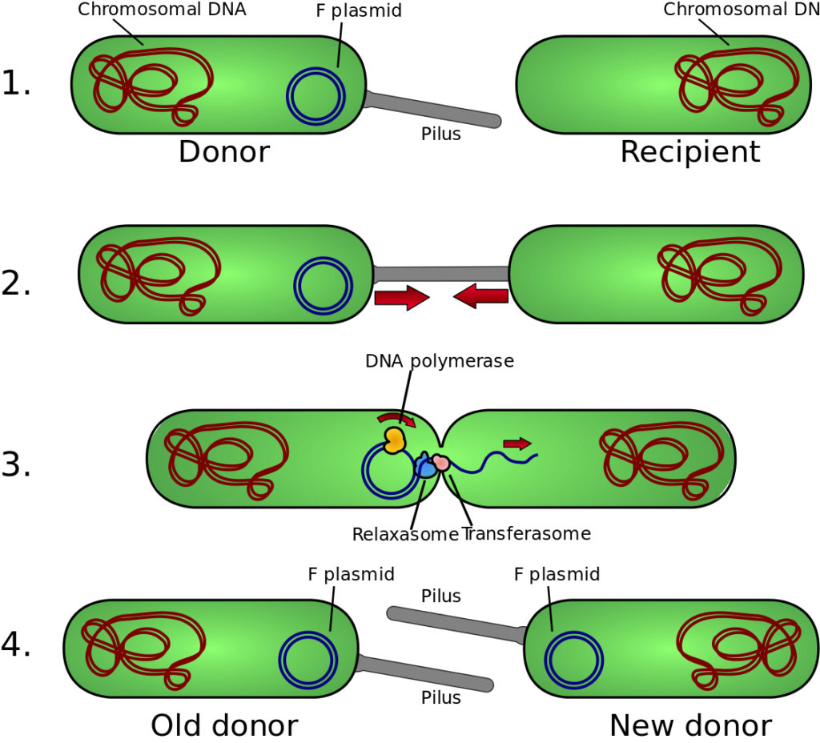
Conjugation
Bacterial conjugation is the transfer of genetic material between bacteria through direct cell-to-cell contact or through the bridge-like connection between the two cells.
Direct transfer via the connection tube, one-way traffic from donor cells to the recipient cells.
Conjugation is a mechanism of horizontal gene transfer.
It is not the reciprocal exchange of genetic information.

Slide 5
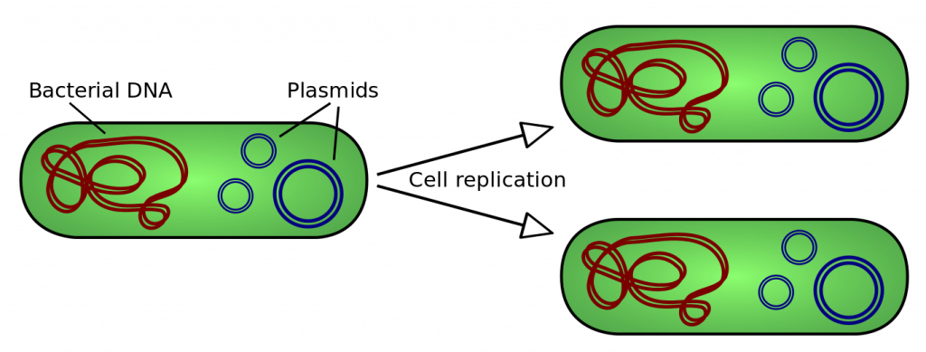
Transformation
A bacterium takes up DNA from the medium.
Recombination takes place between the introduced genes and the bacterial chromosome.
Genetic transformation is the incorporation of naked DNA from an extracellular environment.
Can use plasmids as a vector.

Slide 6
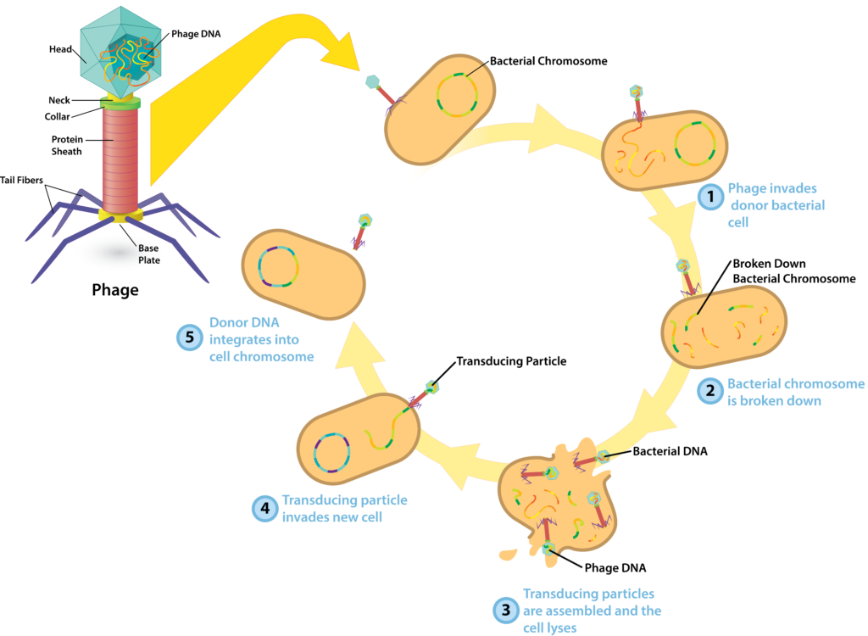
Transduction
The transfer of genetic material from one cell to another cell by the bacteriophage is called transduction.
Transduction usually occurs in a variety of prokaryotes, including certain species of bacteria.
The bacteriophage which contains the bacterial DNA is called transduced DNA.

Slide 7
Gene Transfer methods in Animals
DNA microinjection
Electroporation
Liposome mediated gene transfer
Gene gun

Slide 8
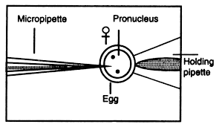
DNA microinjection
It is technique of delivering foreign DNA into living cell through a glass micropipette.
It is used to manually inject DNA from one organism into the egg of another mostly in early after fertilization when ova have two pronuclei.
It is used to identify the characteristics function of dominant genes.
It can be used for creating transgenic organisms particularly mammals.

Slide 9
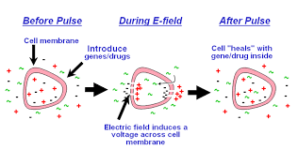
Electroporation
A method used to apply an electric current across a cell membrane resulting in temporary pore formation enabling the uptake exogenous molecules found in the medium.
It is a process that is used to introduce foreign genes into a host cell through new pores and incorporated them into genome of host cell.
This technology allow to safely and effectively deliver DNA vaccines

Slide 10
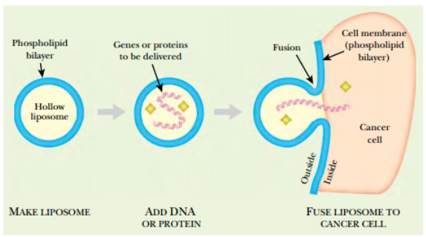
Liposome mediated gene transfer
Liposome are fluid filled spherical vesicles made of phospholipids molecule and also produced from other lipids.
These liposomes work to deliver DNA/drug by diffusion
Liposomes are artificial phospholipid vesicles can be preloaded DNA for transformation by membrane fusion and endocytosis.
This complex fuses with the cell membrane of target cell and release drug/DNA into target cell.

Slide 11
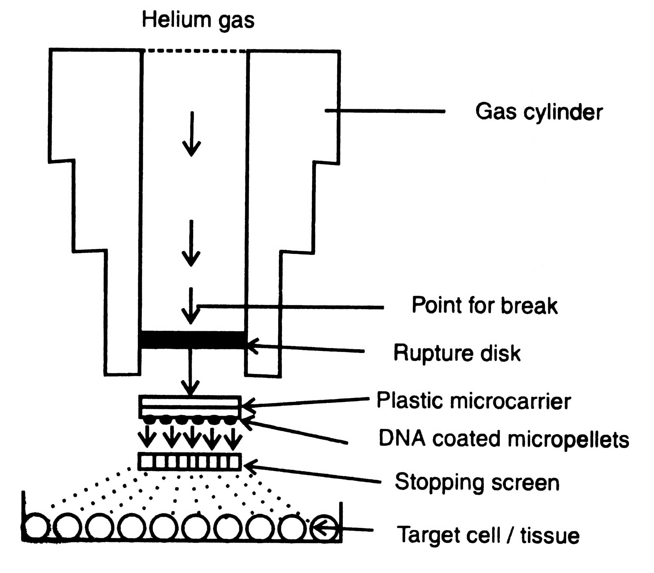
Gene gun
a gene gun is a device used to deliver exogenous DNA (transgenes), RNA, or protein to cells.
In this method gold or tungsten particles are covered with the DNA which are used to alter tissue.
These particles are drived at high speed into plant material, DNA delivered inside the cell and able to add in genome.

Slide 12
Thank You

